Slide 1
Supply chain management
Chapter 6

Slide 2
SCM – some definitions
Supply chain management (SCM)
The coordination of all supply activities of an organization from its suppliers and partners to its customers
Upstream supply chain
Transactions between an organization and its suppliers and intermediaries, equivalent to buy-side e-commerce
Downstream supply chain
Transactions between an organization and its customers and intermediaries, equivalent to sell-side e-commerce

Slide 3
SCM – some definitions
What’s Supply Chain Management?
The design, planning, execution, control, and monitoring of supply chain activities with the objective of creating net value,
building a competitive infrastructure,
leveraging worldwide logistics,
synchronizing supply with demand, and
measuring performance globally.

Slide 4
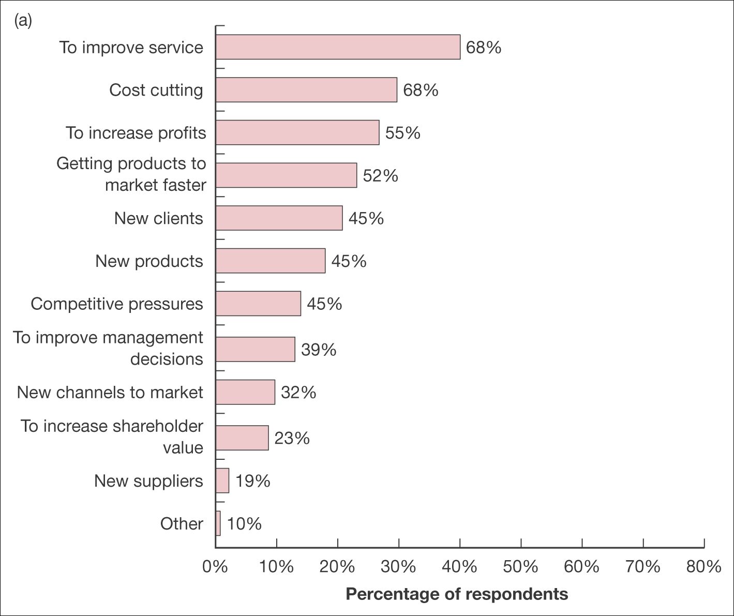
Figure 6.1 (a) Benefits of supply chain management, (b) realization of benefits. Note respondents could select all benefits that apply Source: PMP (2008)

Slide 5
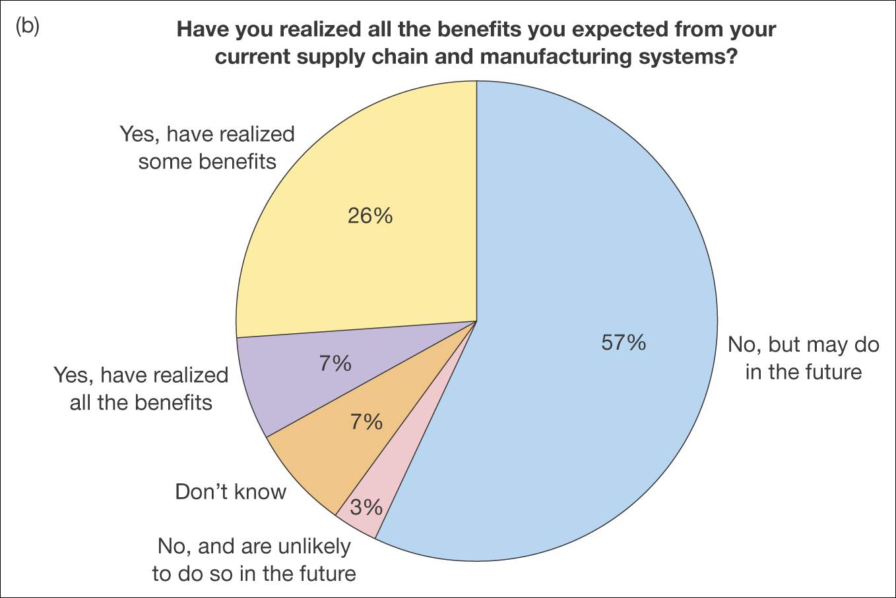
Figure 6.1 (a) Benefits of supply chain management, (b) realization of benefits. Note respondents could select all benefits that apply (Continued) Source: PMP (2008)

Slide 6
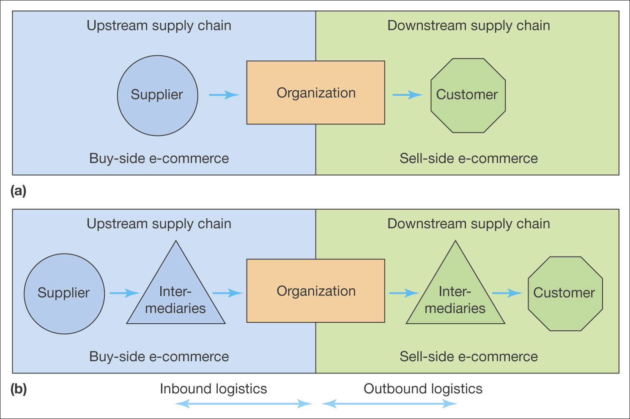
Figure 6.2 Members of the supply chain: (a) simplified view, (b) including intermediaries

Slide 7
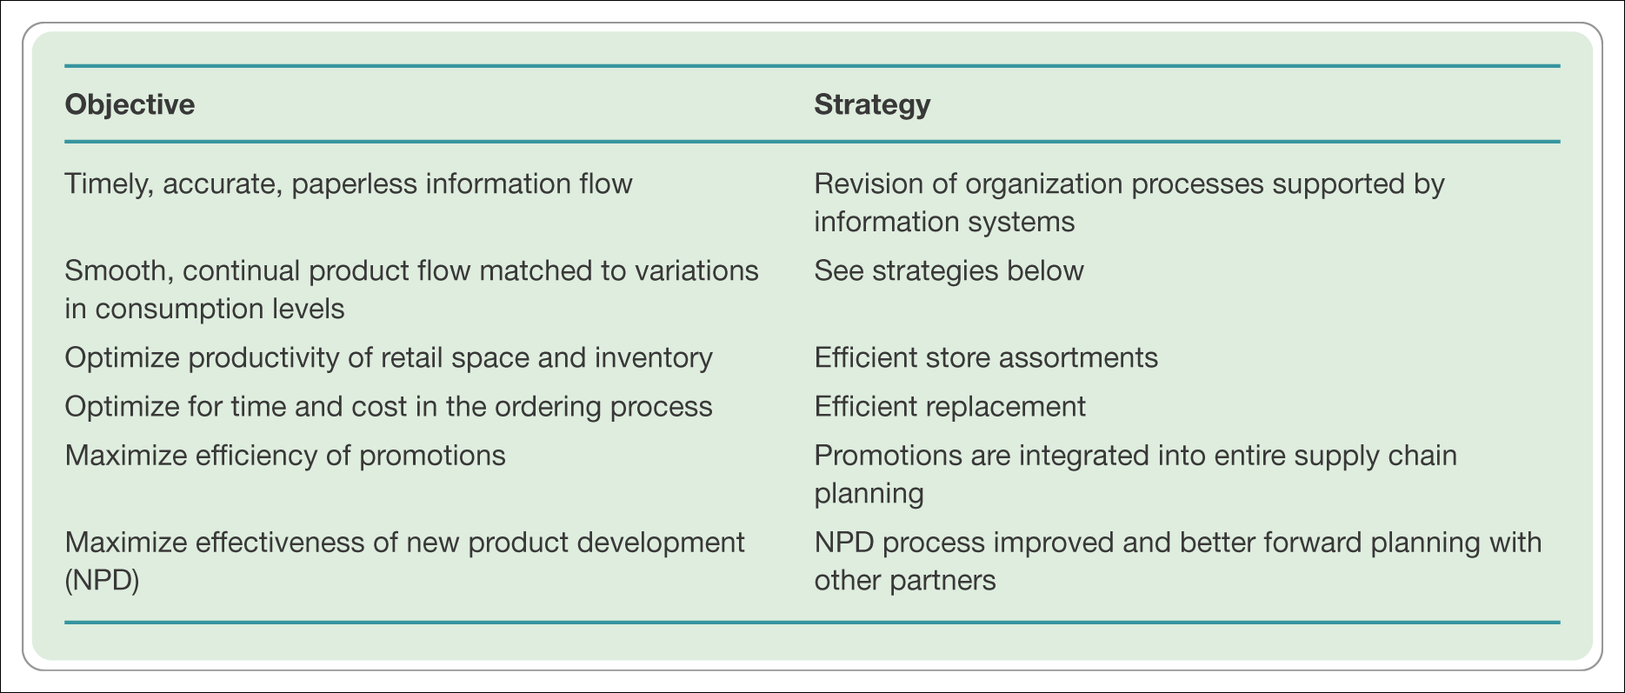
Table 6.2 Objectives and strategies for effective consumer response (ECR)

Slide 8
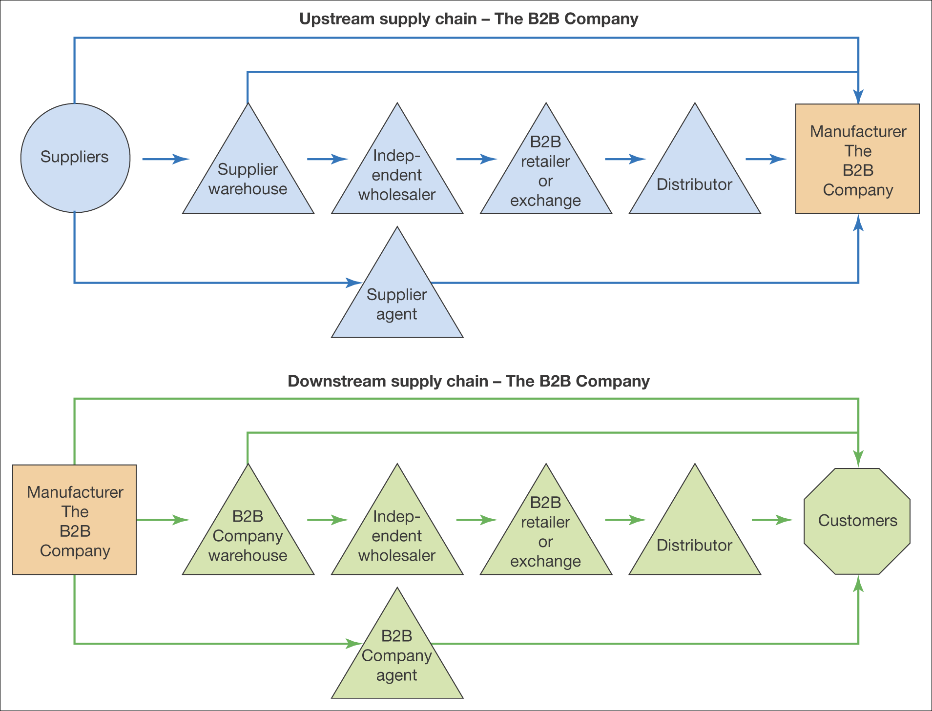
Figure 6.5 A typical supply chain for a B2B company

Slide 9
Push and Pull SCM
Push SCM—emphasis distribution product to passive customers
Pull SCM—emphasis delivery of values to customers who actively involved in product and service specification

Slide 10
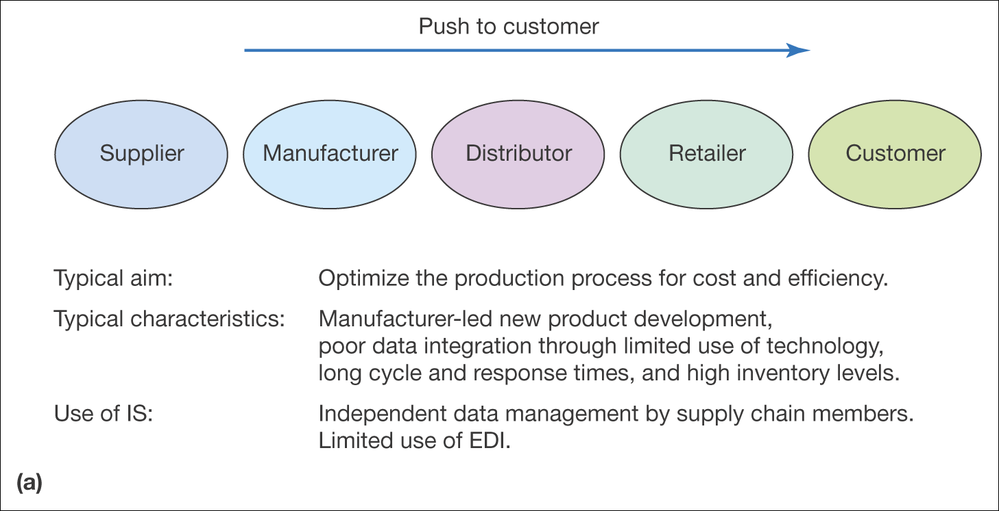
Figure 6.7 Push and pull approaches to supply chain management

Slide 11
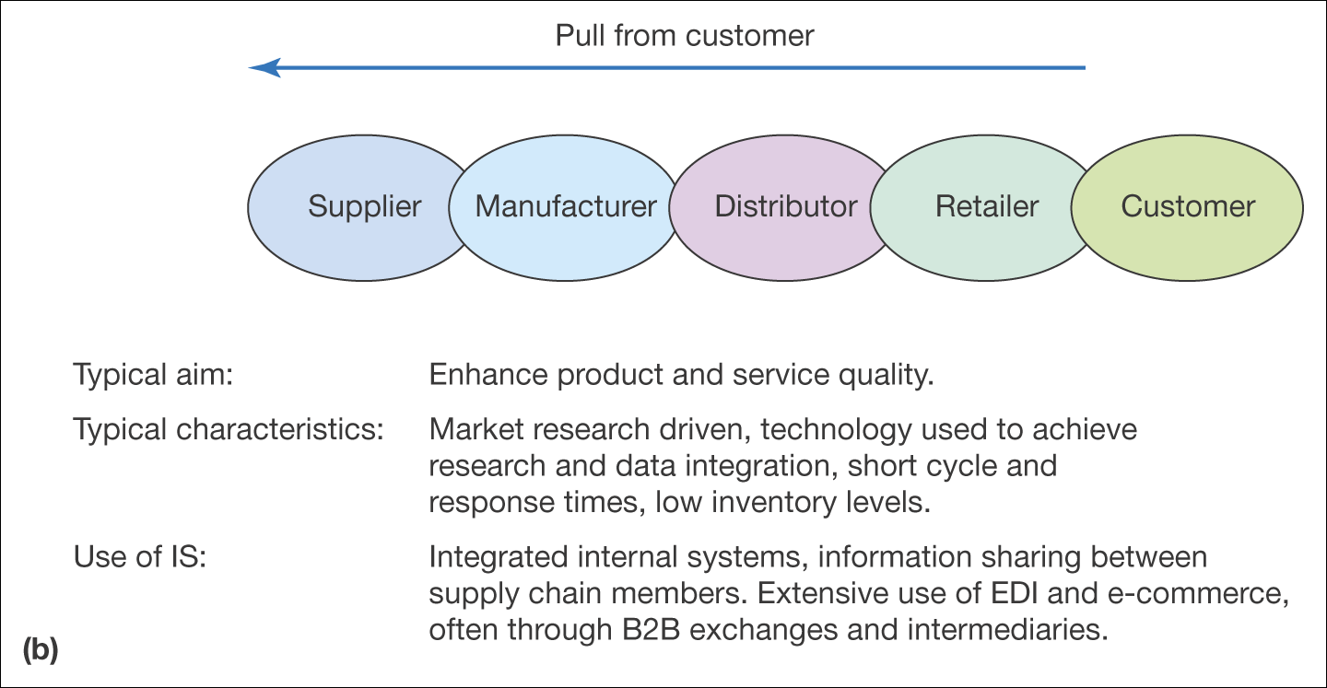
Figure 6.7 Push and pull approaches to supply chain management (Continued)

Slide 12
Value Chain
A model that considers how supply chain activities can add value to products and services delivered to the customer.
A tradition value chain model was proposed by Porter in 1980
A new value chain model was proposed by Deise et all in 2000

Slide 13
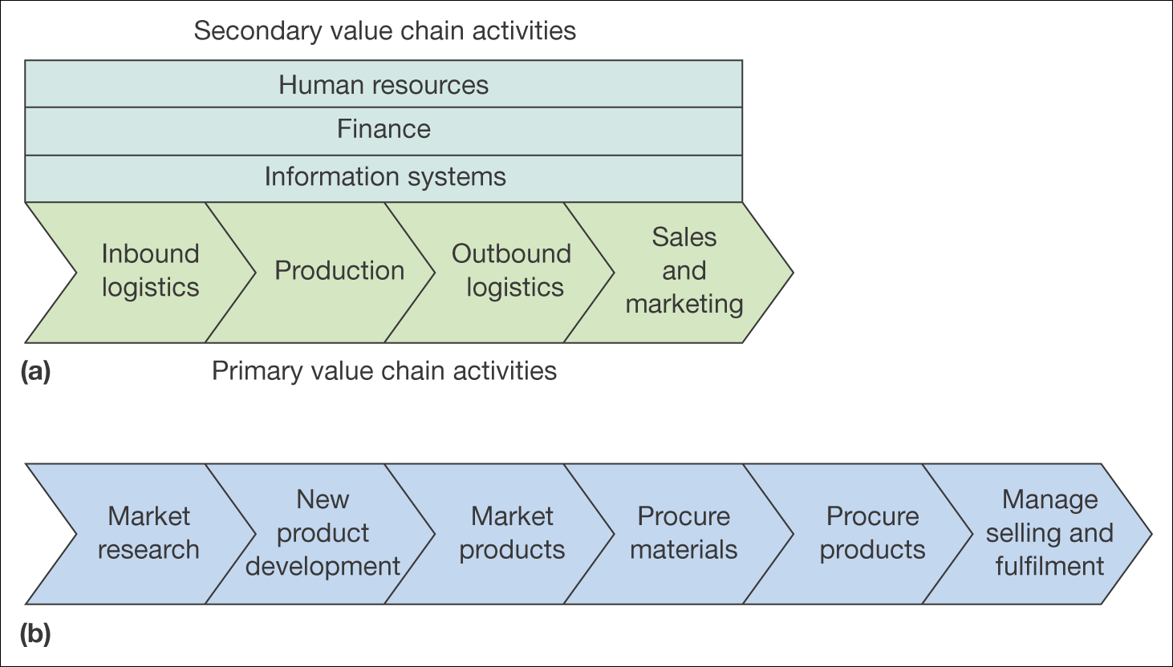
Figure 6.8 Two alternative models of the value chain: (a) traditional value chain model, (b) revised value chain model Source: Figure 6.4(b) adapted from Deise et al. (2000)

Slide 14
Value Chain Analysis
A framework that decomposes an organization into its individual activities and determines value added at each stage.
Activities can be divided into 3 categories
Create value as perceived by customers
Create no value but required by product development/production
Those that don’t add value at all.

Slide 15
Value Chain Networks
Also called external value chain—The link between an organization and its strategic and non-strategic partners that form its external value chain.

Slide 16
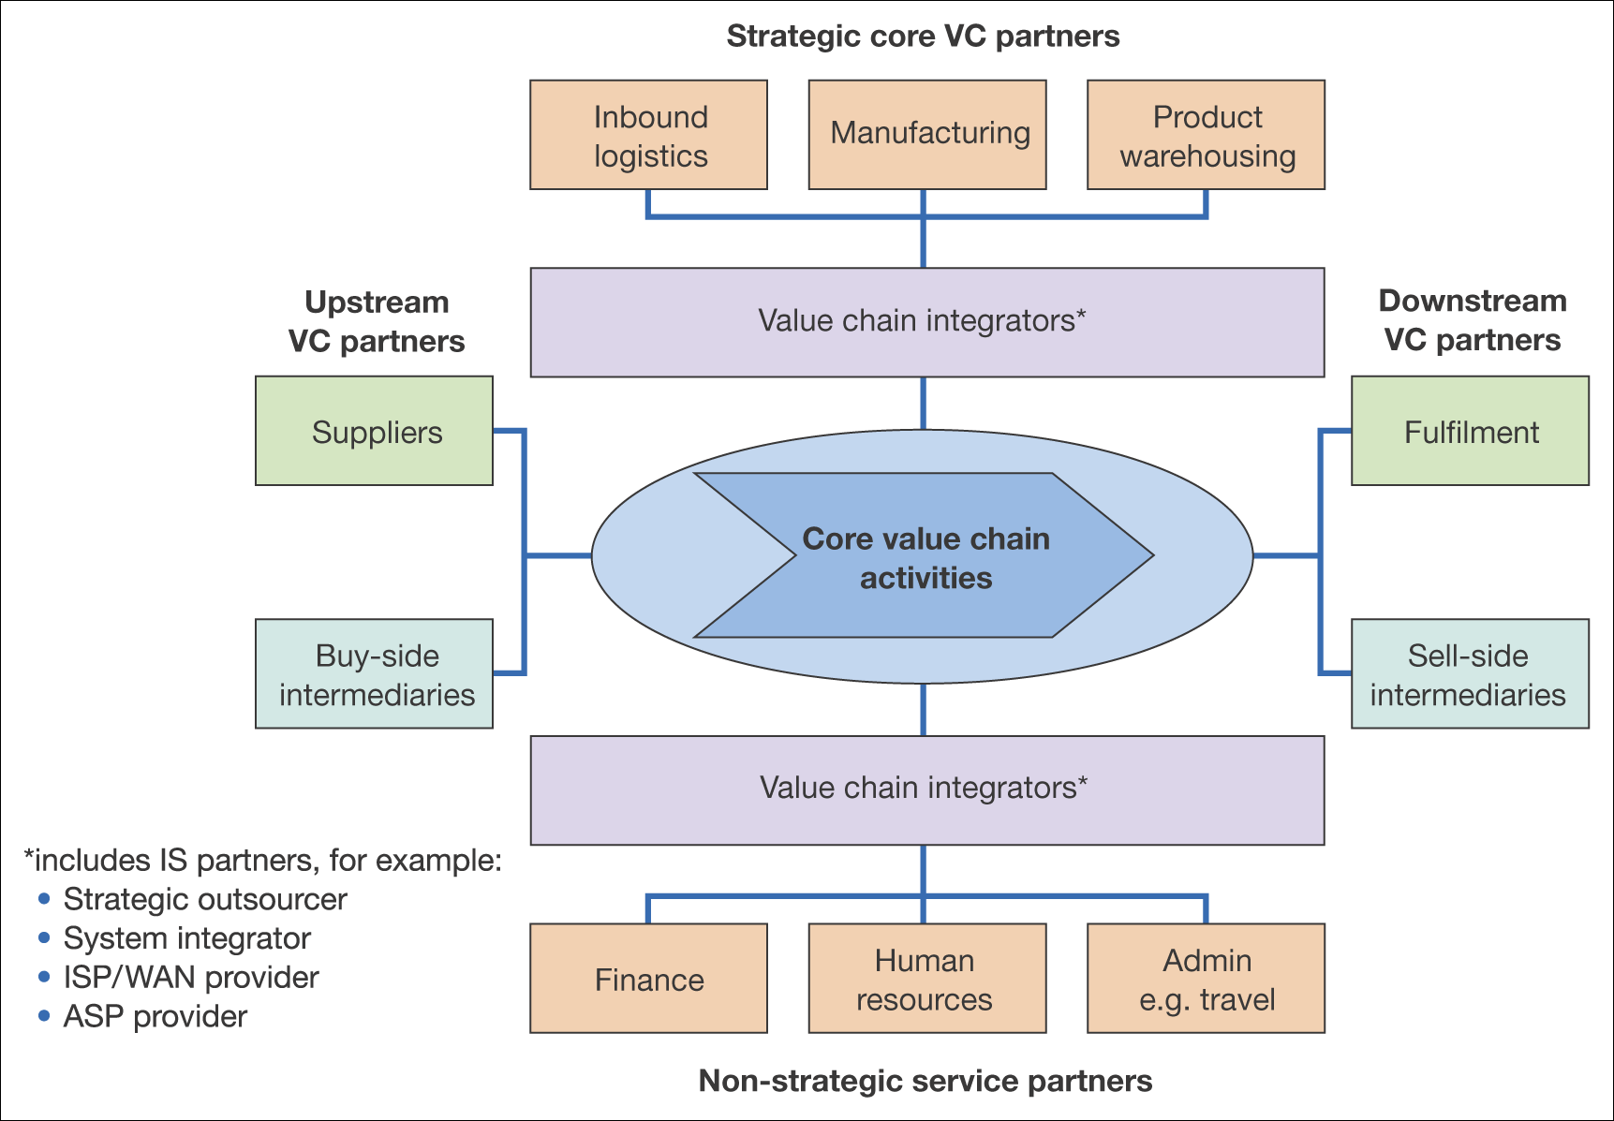
Figure 6.9 Members of the value network of an organization (adapted from Deise et al. 2000)

Slide 17
Restructuring Supply Chain
A SCM can be viewed from control perspective-internal and external.
Vertical integration—supply chain activities are undertaken and controlled by the organization
Virtual integration—majority of supply chain activities are undertaken and controlled by third party

Slide 18
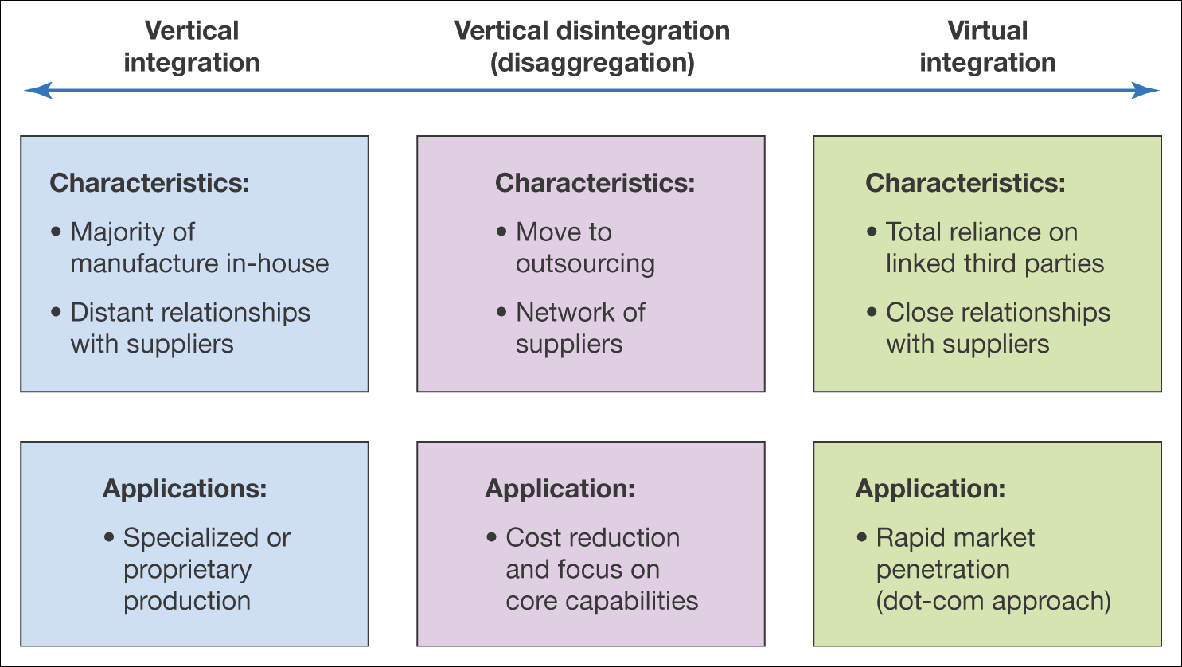
Figure 6.10 The characteristics of vertical integration, vertical disintegration and virtual integration

Slide 19
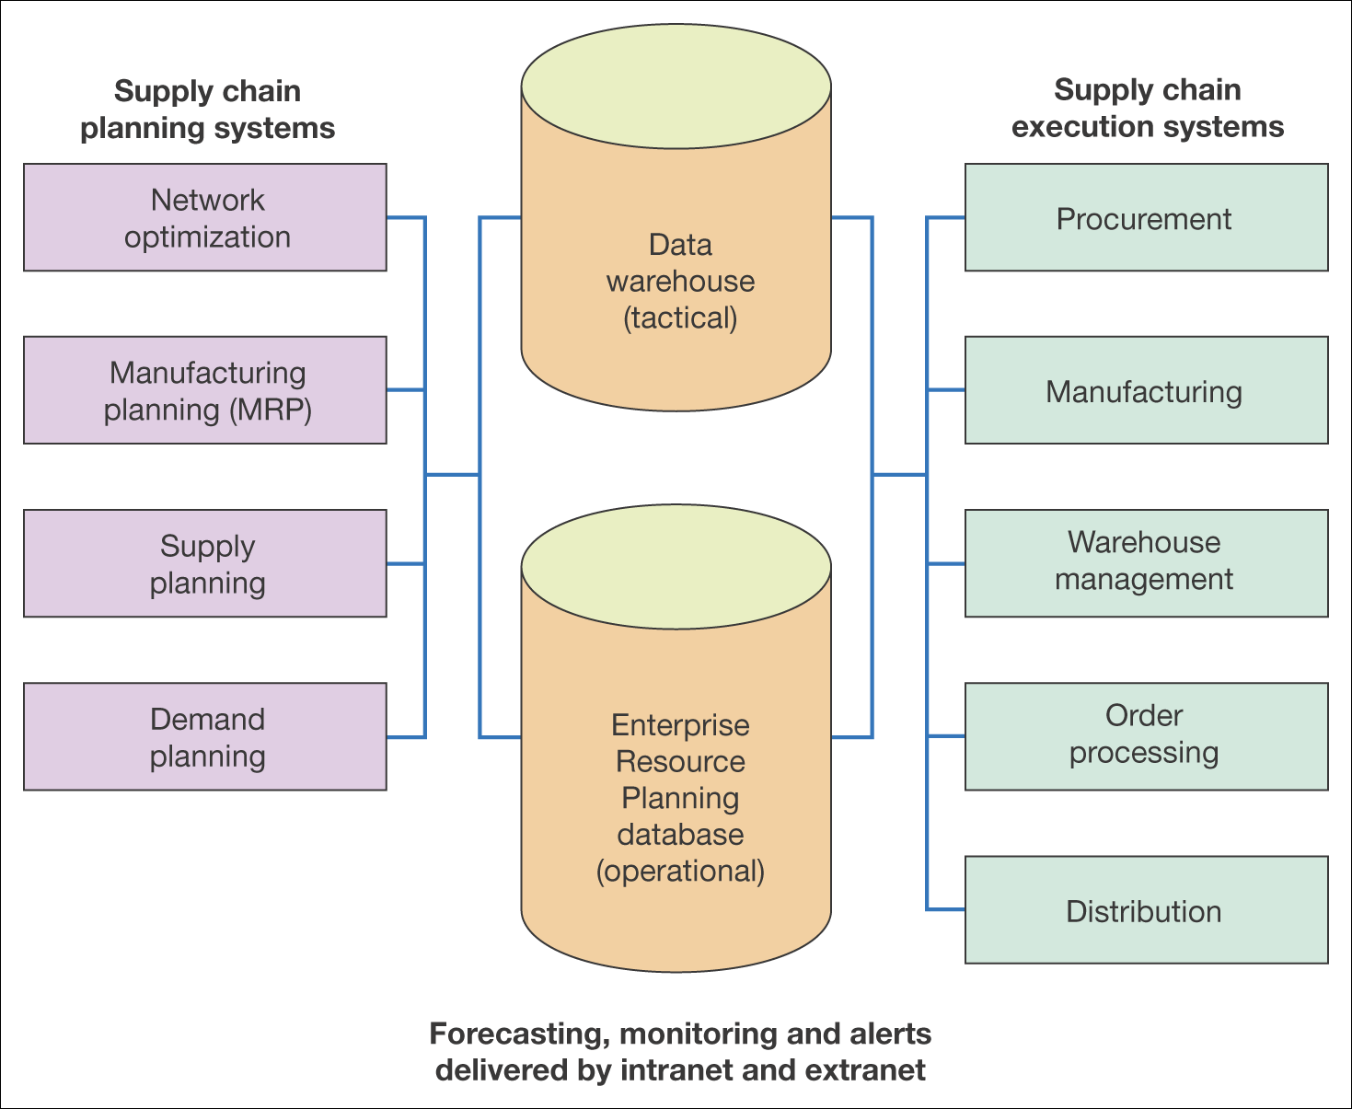
Figure 6.13 A typical IS infrastructure for supply chain management

Slide 20
SCM Strategy Process
Managing Partnerships
It’s advised that a company should
Focus on core competencies
Reduce their number of suppliers
Develop strong partnership relationships
Strategic options for partnerships

Slide 21
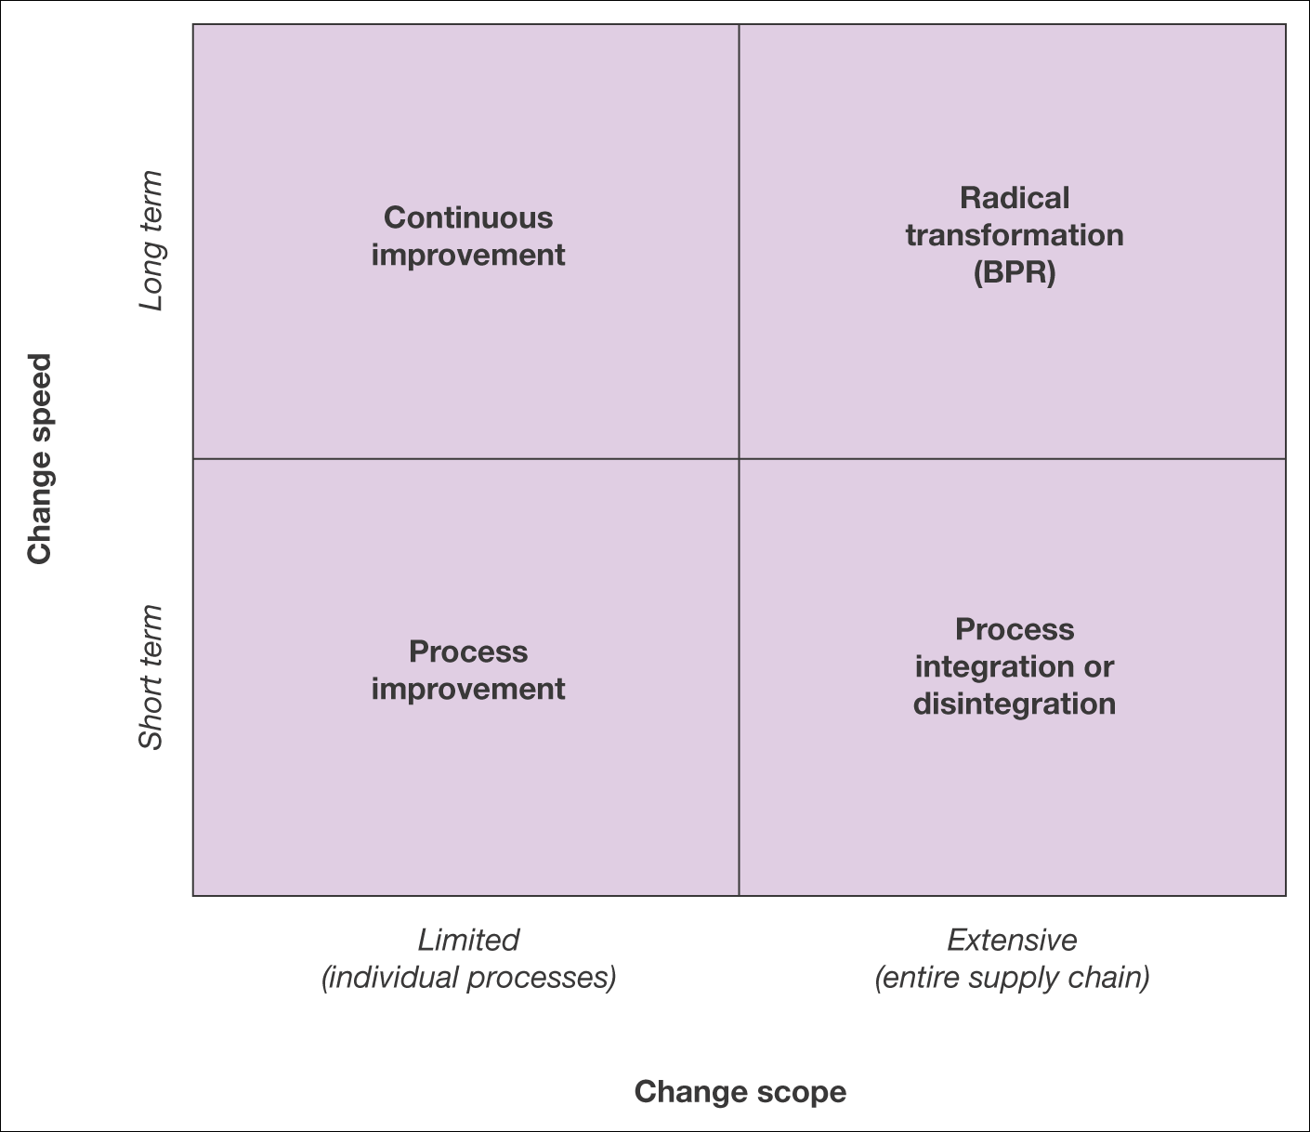
Figure 6.14 Alternative strategies for modification of the e-business supply chain
-Limited in scope apply to individual processes such as procurement or outbound logistics and results in delivering improvement at an operational level.
-This may give short term benefits while minimizing the risk of radical change
-Where the scope of change is more extensive there is a greater risk. And the greater potential reward.
-Includes complete re-engineering of processes or major changes to the supply chain.

